Slide 1
Voxel-Based Alignment and Tumor Extraction from Liver CT Scans
11763 - Medical Image Processing
Irving Perez Uribe

Slide 2
INTRODUCTION
This project focuses on the visualization and alignment of 3D medical imaging data using DICOM CT scans and their associated segmentation masks. The main objective is to develop a reproducible and interpretable pipeline for loading, preprocessing, and rigidly registering volumetric medical data, with emphasis on liver and tumor segmentation. The work is divided into two tasks.
In Task 1, we implemented a pipeline to load and normalize CT and segmentation volumes, generate anatomical overlays, and create an animated visualization using Maximum Intensity Projection (MIP) in sagittal and coronal planes. This enabled clear identification of tumoral regions and assessment of anatomical structure. In Task 2, we performed rigid registration of a CT scan to a reference phantom volume.

Slide 3
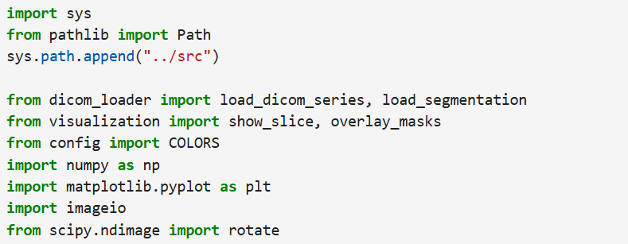
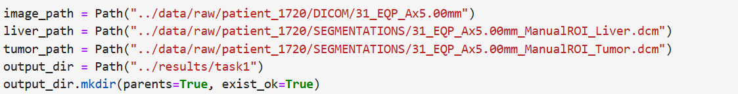
Task 1. DICOM Loading and Visualization
Import libraries
Define Input and Output Paths

Slide 4
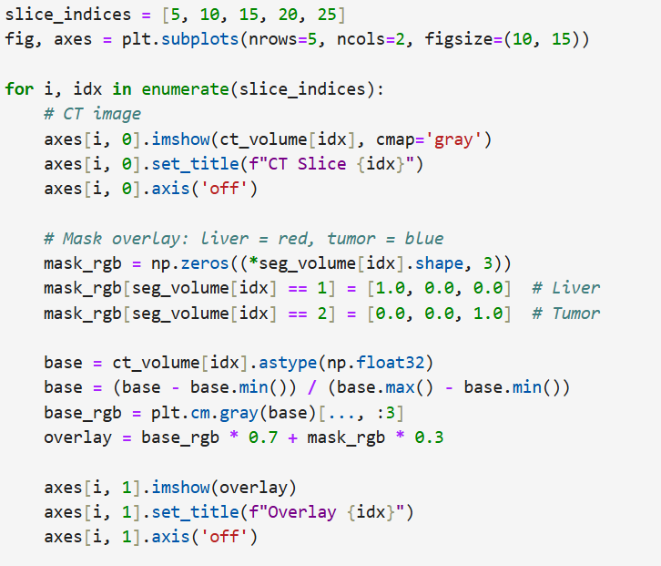
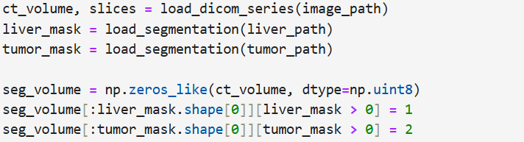
Task 1. DICOM Loading and Visualization
Load CT and Segmentation Data
Visualize Individual Slices

Slide 5
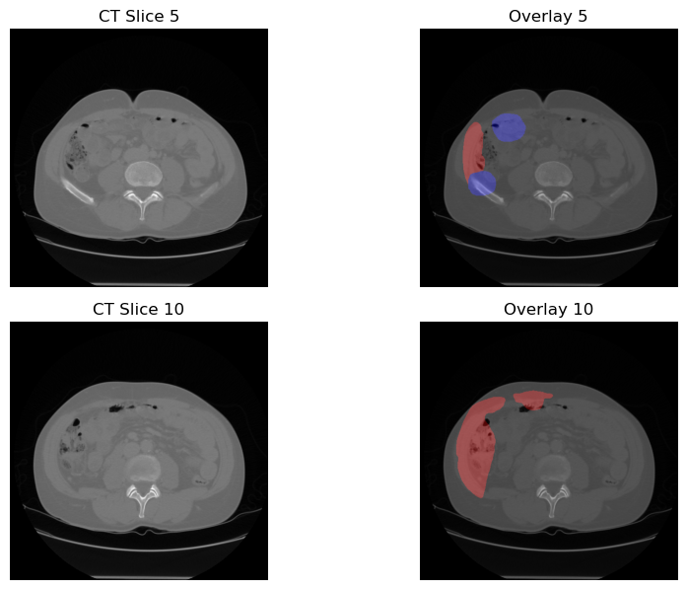
Task 1. DICOM Loading and Visualization

Slide 6
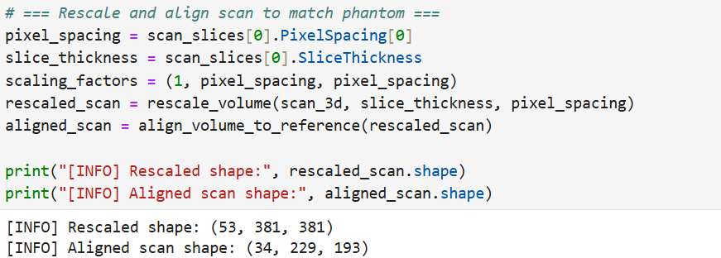
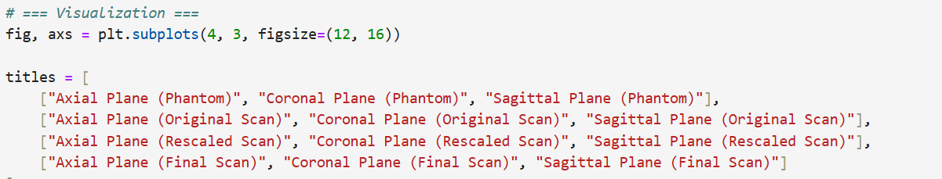
Task 2: Rigid Registration and Segmentation
Aligned scan shape and visualization

Slide 7
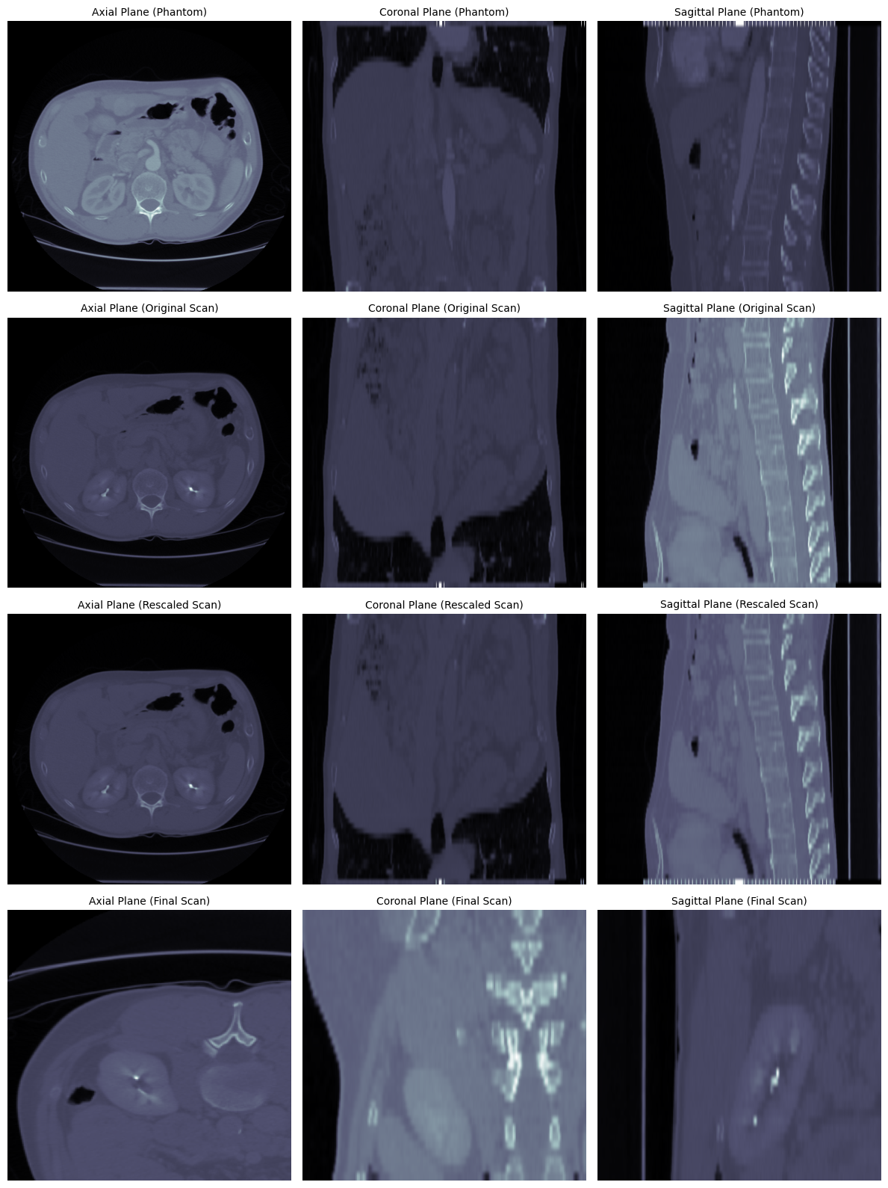
Task 2: Rigid Registration and Segmentation

Slide 8
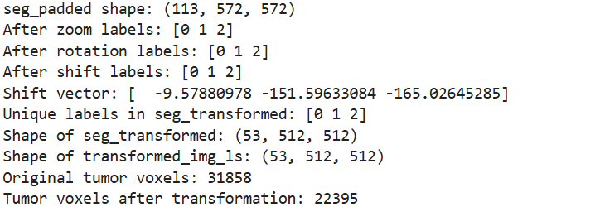
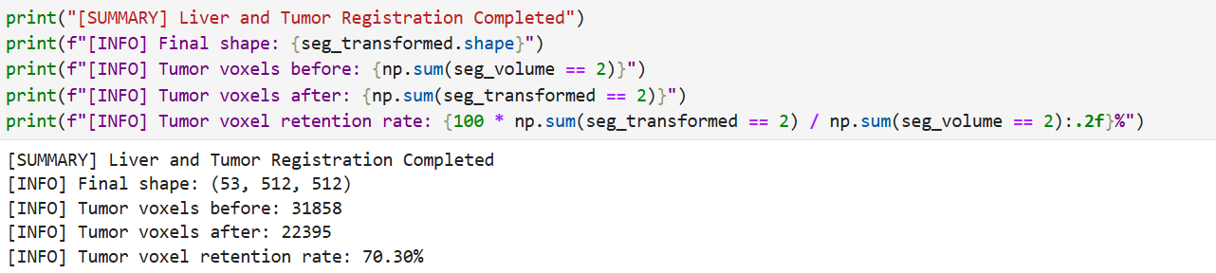
Task 2: Rigid Registration and Segmentation
Liver and Tumor Registration

Slide 9
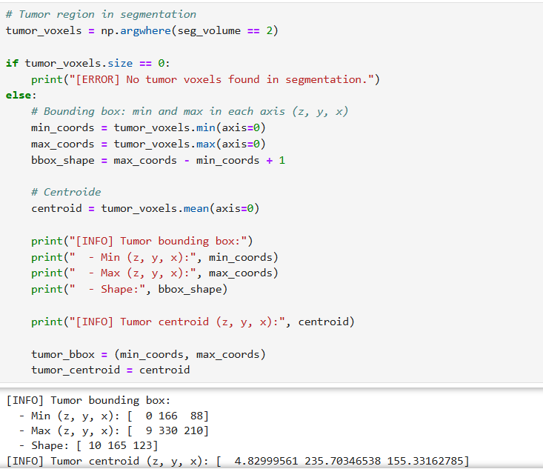
Task 2: Rigid Registration and Segmentation
Tumor Centroid

Slide 10
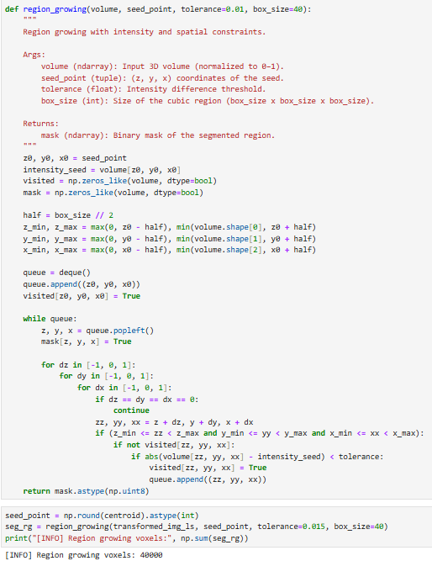
Task 2: Rigid Registration and Segmentation
Region growing

Slide 11
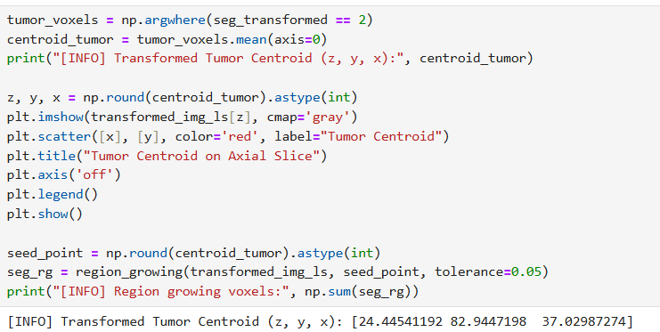
Task 2: Rigid Registration and Segmentation
Transformed Tumor Centroid

Slide 12
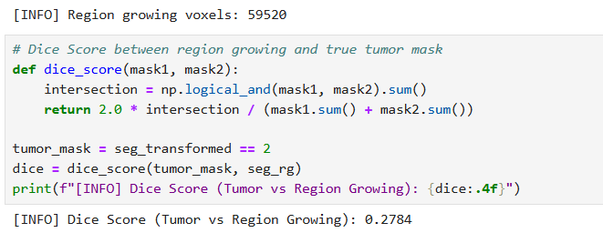
Task 2: Rigid Registration and Segmentation
Dice Score (Tumor vs Region Growing)

Slide 13
Task 2: Rigid Registration and Segmentation

Slide 14
CONCLUSIONS

Slide 15
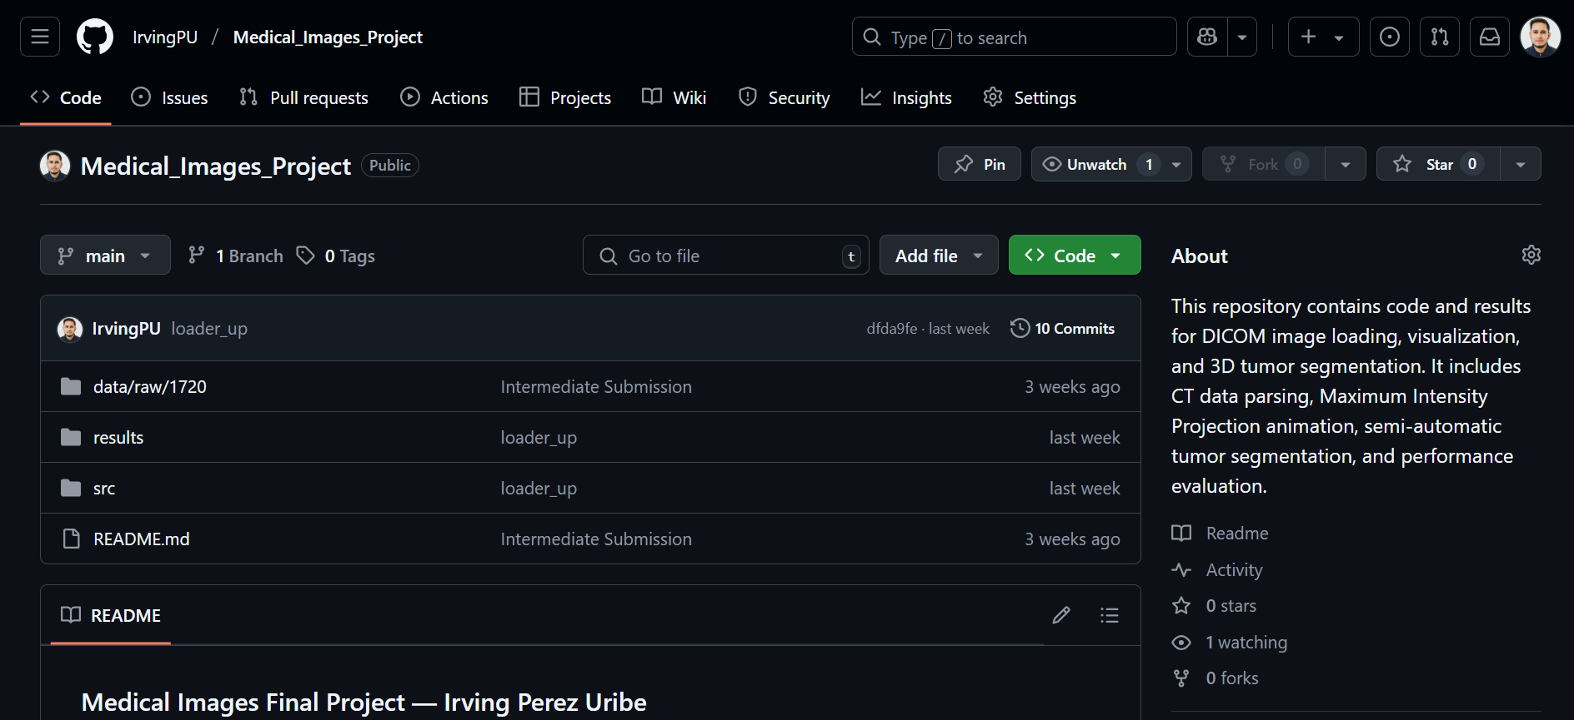
CONCLUSIONS
GitHub: https://github.com/IrvingPU/Medical_Images_Project.git

Slide 16
THANK YOU!!

